Slide 1

GitOps For The Distributed Enterprise Edge
Darryl Cauldwell

Slide 2
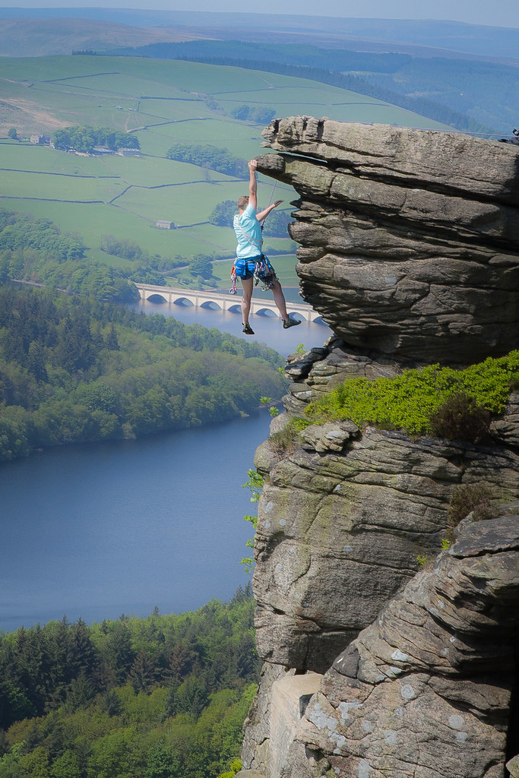
What is edge computing?
https://www.flickr.com/photos/eddie_austrums/27391047687/
Notes:
What is the edge? Well it has been around for a long time and can mean different things to different people.

Slide 3

Royal Mail IT Services
1993 - 2003
48,000 Vehicles of which 1,110 Parcelforce vehicle edge
Analogue carphone, modem and compute device.
Send back to central service centre application lifecycle.
Lifecycle management was slow and expensive.
37 sorting offices and 1,356 Royal Mail delivery offices
Windows PCs running apps for track and trace, route planning, revenue protection systems and MS Office.
“Man in a van” systems administration and application lifecycle.
Poor configuration management, slow rollout of new app versions and very expensive.
Notes:
My first roles in IT was with Royal Mail.
I first worked with Parcelforce on their cab communications system. Essentially a car phone, a modem and a compute device. With this edge solution software rollout was slow and expensive with all devices sent back to our central team.
I then moved to the field driving around delivery offices with bundles of floppy disks. This was hard to scale, configuration drift was a nightmare and it was very expensive.

Slide 4


VMware
2019 - present
Customer Success Architect
Cloud Foundation: vSphere, vSAN, NSX, Aria suite
Tanzu: App Modernisation, Spring Framework, Cloud Foundry, Kubernetes, Mission Control, Service Mesh
Telco Cloud: RAN Disaggregation, Private 4/5G, OpenStack, Cloud Director
Secure Access Service Edge: Edge Compute Stack, SD-WAN, Edge Intelligence
Office of CTO Ambassador
Sustainable Software
Serverless (Knative)
Edge
Notes:
Fast forwards a 30 years and I’m still helping customers with edge and other solutions. I work across the full VMware suite of products and across industry verticals.
I am also aligned to the Office of the CTO. Spend 20% of my time working on R&D projects. Focus on sustainable software, serverless and the edge.

Slide 5
Near Edge
Factories
Supervisory control and data acquisition (SCADA)
SCADA Intrusion Detection
Predictive Maintenance - Computer Vision
Quality Inspection - Computer Vision
Programable Logic Controller (PLC)
Physical security - Computer Vision
Few nodes with shared storage, cluster for availability and resilience.
Data centre WAN connectivity and management plane.
Optimised to run low latency applications.
dGPU enabled Artificial Inteligence.
Warehouses
Quality Inspection - Computer Vision
Theft prevention - Computer Vision
Logistics
Electricity Transmission Sub-stations
Protection automation control (PAC)
Realtime overhead line telemetry processing
Intel­li­gent Elec­tron­ic Devices (IED)
Supervisory control and data acquisition (SCADA)
SCADA Intrusion Detection
Physical security - Computer Vision
Notes:
Edge customers typically have multiple remote sites which run applications which connect back to data centres systems. In recent years the edge application landscape has grown extensively and become unwieldy.
Some examples of edge locations would be:
- Factories, Warehouses and Electricity transmission sub-stations
Some examples applications include:
Security, both physical buildings security and computer security
PLC and SCADA, industrial control systems,

Slide 6
Distributed Edge
Retail
Point of Sale (PoS) - Computer Vision
Theft prevention - Computer Vision
Quality Inspection - Computer Vision
Inventory management
Single, or small number of nodes with resource constrained hardware.
4/5G connectivity, SD-WAN.
Optimised to run low latency applications.
iGPU enabled Artificial Inteligence.
Vehicles / ships
Predictive Maintenance - Computer Vision
Physical security - Computer Vision
Intelligent Battlefields
Armoured vehicles
Signals intelligence
Telemetry processing
Drone operation
Electricity Distribution Sub-station
Protection automation control (PAC)
Intel­li­gent Elec­tron­ic Devices (IED)
Physical security - Computer Vision
Worker Safety - Computer Vision
Notes:
There fastest moving area of edge at the distributed edge. Typically these are many hundreds and potentially thousands of widely distributed remote locations. Due to the scale these are mostly low cost commodity hardware connecting back to cloud services via the 4/5G networks.

Slide 7

Wind Turbines Predictive Maintenance
72,000+ turbines
  Management at scale
  Observability at scale
  Low cost commodity hardware
Consistent infrastructure deployment and configuration
Rapid, consistent iteration and delivery of computer vision inference models
Automated, zero touch provisioning
Secure 5G connectivity
Wind Turbine
Cloud
Thermal imaging camera
Stream capture and pre-process
Model Training Service
Inference engine
Event Trigger
Control Center
Camera
PLC Turbine Control
Notes:
So if we look closer at the use case of how this might be used. And we look at.enabling predictive maintenance of wind turbine fleet. The solution would be a camera and thermal imaging camera streaming views of of the machinery. These image streams are processed by an inference engine which looks for anomalies if found the event triggers the turbine to alter its behaviour and notify control centre. Not all possible anomalies are understood by the inference engine and so stream also feeds a cloud for model training and improvement. The refined model needs quick distribution to the fleet.

Slide 8
Why data processing at the edge?
“55% of all data analysis by deep neural networks will occur at the point of capture in an edge system by 2025” *
Real-time decision making
Increase app reliability, responsiveness and security
Reduce bandwidth and infrastructure costs
Enhanced customer experience
Enhanced data privacy and security
* Source: Gartner Identifies Top Trends Shaping the Future of Data Science and Machine Learning, August 2023
Notes:
Looking at the applications across edge locations there is a use case pattern emerges. Data processing and the use of AI inference engines at the edge.

Slide 9
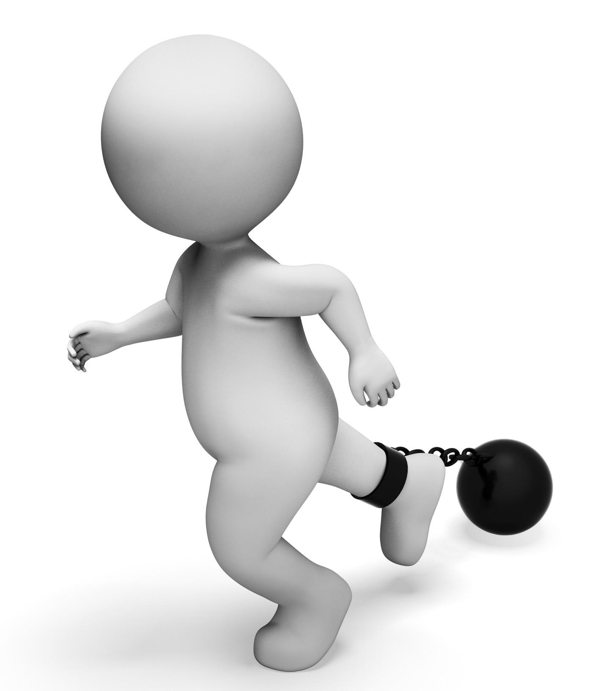
Common edge constraints
Application
Many existing apps may not be modernised for years…or ever
Configuration drift
Lifecycle management complex
Limited inelastic compute
Applications tied to specific hardware
GPUs tied to specific applications
Organic growth, disparate hardware and operating systems
Limited network
High latency, low bandwidth
Potential outages to central management systems.
Siloed Data
Pockets of data distributed in silos
People Skillset
Few trained in IT at the edge locations.
Few dedicated to Edge in central IT.
https://jooinn.com/ball-and-chain-means-conquering-adversity-and-bound-3d-rendering.html
Notes:
Some of the largest constraints today are the same as they were 30 years ago with my work at Royal Mail namely:
Application lifecycle management.
Configuration management across a large distributed sites.
Few trained in IT at the edge, and few dedicated to edge in central IT.

Slide 10
VMware Edge Cloud Orchestrator (VECO)
xLabs
xLabs is a program within the Advanced Technology Group in VMware’s Office of the Chief Technology Officer.
Cultivating cutting-edge technologies in collaboration with partners, and customers.
Tech Showcase
Zero touch provisioning of infrastructure and applications.
GitOps workflows for day zero and day two operations.
  Infrastructure and applications desired state manifest files in a git repository.
VM and container based applications run side-by-side
Consumer grade hardware
Notes:
As part of alignment to OCTO I have been working on a edge project which aims to offer customers a GitOps workflow for device edge estate management and control. With edge hosts capable of running VMs and containers side by side on consumer grade hardware.

Slide 11
VECO Architecture
Management Plane
Lifecycle Management
Site Profiles
Visibility
Monitoring
Auditing
Control and Data Plane
Control and Data Plane
Control and Data Plane
VMs
Containers
VMs
Containers
VMs
Containers
ESXi
ESXi
ESXi
Notes:
The high level architecture is a cloud management plane and each edge site has its own control and data plane.

Slide 12
Switch to Keswick console
https://veco.showcase.vmware.com/#/launchpad

Slide 13



GitOps Workflow
firmware.yml
esxconfig.yml
vm.yml
container.yml
Declarative source of truth for entire stack
Update to source of truth triggers pipeline
Configuration pulled and realised by each device
Notes:
The different aspects of the edge configuration are stored in yaml files in Git repository.
The flux continuous delivery engine is configured to poll repository every 60seconds.
Flux pulls the configuration and hands to Kubernetes Kustomize to realise the configuration.

Slide 14
Switch to Git repo
https://github.com/darrylcauldwell/keswick

Slide 15
Zero touch provision and operate
Ship OEM ships edge box(es) to site
Plug in Person at site edge box connects edge box(es)
Setup Edge agent contacts cloud service, authenticates, pulls configuration, updates itself
Day 2 operations the edge agent notices mismatch with desired state and acts to resolve
Notes:
There can be no assumed IT skills at the device edge as such zero touch provisioning is used. The device gets shipped with just enough configuration to connect and authenticate with the cloud service to pull its configuration.

Slide 16
ESXi Operator in Kubernetes
ESXi Operator in Kubernetes
HostConfiguration
kubectl get crd | grep esx
hostconfigurations.esx.vmware.com
kubectl -n esx-system get HostConfiguration
NAME
esx-base-profile
keswick-host-config
Notes:
In order for Kustomize to manage ESXi host configuration VMware wrote a Kubernetes HostConfiguration Operator. This connects to the ESXi APIs to enact the configuration pulled from the git repository.

Slide 17
VM Operators in Kubernetes
VM Operators in Kubernetes, introduced vSphere 7.0 U2a
VirtualMachine, VirtualMachineImage, VirtualMachineClasses and VirtualMachineServices
kubectl get crd | grep vmoperator
contentsourcebindings.vmoperator.vmware.com
contentsources.vmoperator.vmware.com
virtualmachineclassbindings.vmoperator.vmware.com
virtualmachineclasses.vmoperator.vmware.com
virtualmachineimages.vmoperator.vmware.com
virtualmachinepublishrequests.vmoperator.vmware.com
virtualmachines.vmoperator.vmware.com
virtualmachineservices.vmoperator.vmware.com
virtualmachinesetresourcepolicies.vmoperator.vmware.com
kubectl get vm -o wide
NAME POWER-STATE CLASS IMAGE
edge-vm guaranteed-small packages.vmware.com/photon/4.0/GA/ova/photon-hw11-4.0-1526e30ba0.ova
Notes:
Kubernetes to control the deployment of VMs this uses the Kubernetes VM Operators introduced with vSphere 7.

Slide 18
Switch to Terminal SSH, host and VM Operators

Slide 19


Demo
OpenCV (Open Source Computer Vision Library) is an open source computer vision and machine learning software library.
OpenCV was built to provide a common infrastructure for computer vision applications and to accelerate the use of machine perception in the commercial products.
Browser
RTSP
Camera
Inference engine
VECO
Git
NUC
Caffe is a deep learning framework. Caffe Face Detector is an OpenCV Pre-trained Model.

Slide 20
Thank you

Slide 21

What is ?

Slide 22
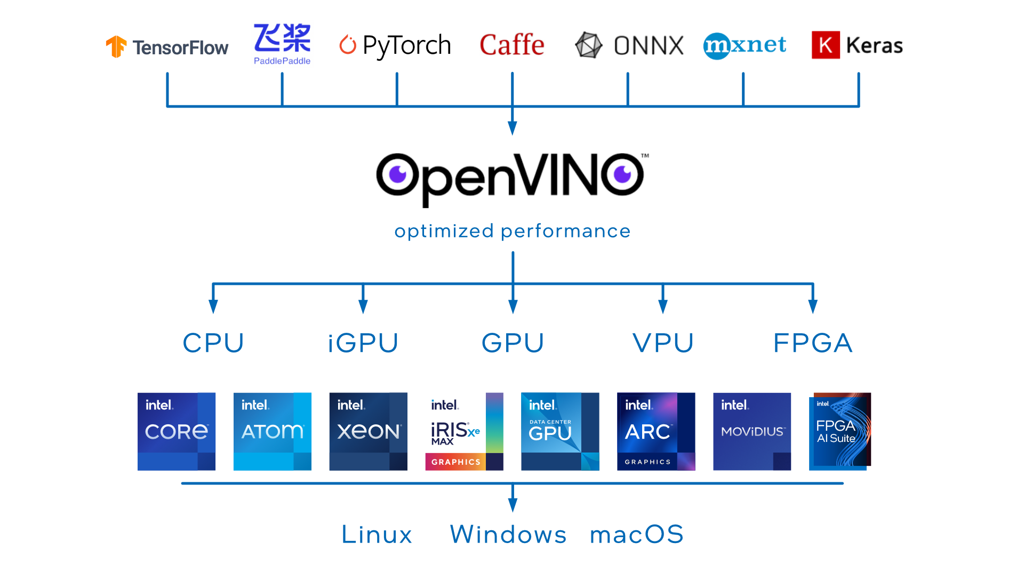
Open OpenSource
V Visual
I Inference
N Neural networks
O Optimisation

Slide 23
AI accelerators for deep learning inference
An AI accelerator is a dedicated processor designed to accelerate machine learning computations.
Deep learning is primarily composed of a large number of linear algebra computations, (i.e. matrix-matrix, matrix-vector operations) and these operations can be easily parallelised.
Inference is often the most time consuming part of your application that directly affects user experience.
iGPU integrated graphics processing on the vast majority of Intel Core and AMD Ryzen processors
dGPU discrete graphics processing unity typically supplied by AMD and Nvidia

Slide 24
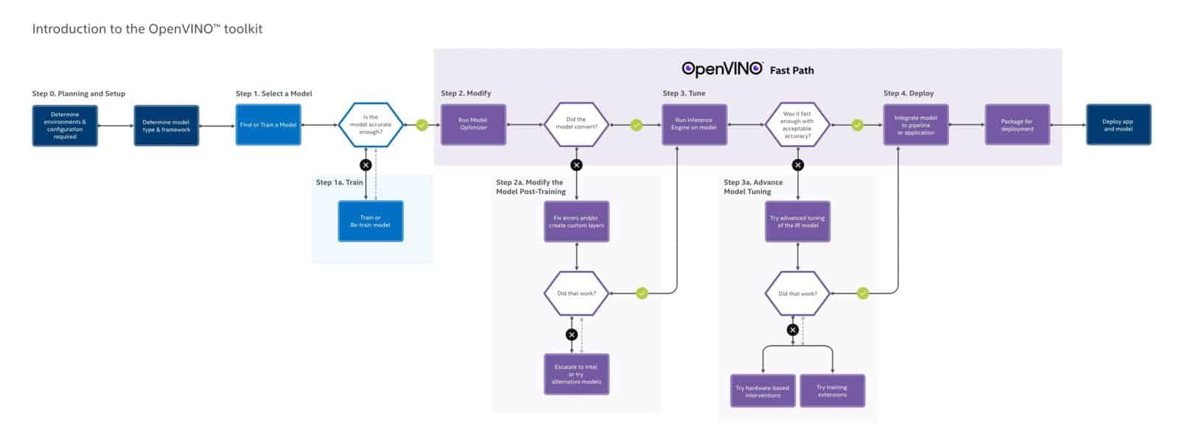

Slide 25



CV App1
CV App2
Passthrough
GPU
GPU
CV App1
CV App2
CV App3
CV App4
vGPU
vGPU
vGPU
vGPU
Shared vGPU ( NVIDIA NVAIE license )

